Slide 1

Department of Information Technology ABES Engineering College, Ghaziabad, UP
MINI PROJECT PRESENTATION SESSION 2022-23
Team Members:-
Yanshi Gupta (2000320130197)
Shruti Sharma (2000320130160)
Sachin Kumar Singh(2000320130137)

Slide 2

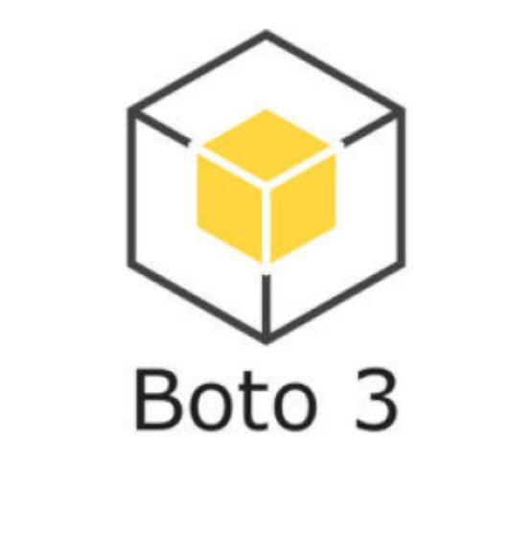
Textractor with AWS
Project Title
+

Slide 3
Contents:
About the company
Objective of course
Course overview
Project based learning
Challenges and limitation
Conclusion
Annexures:(a)Code snippets
(b)Certificate(s)
(c)Project Demo Snippets
(d)References

Slide 4

1) About the Company: AWS Training
It is a subsidiary of Amazon that provides industry-level professional courses on cloud computing and various other fields.
It was founded in the early 2000s along with Amazon AWS services.
It offers professional courses at user friendly prices.
The instructors are also much experienced in their subjects.

Slide 5
2) Objective of course
My course name is “AWS Cloud Practitioner Essentials”
To seek an overall understanding of AWS Cloud.
Describe the basic global infrastructure of the AWS Cloud
To learn about AWS cloud concepts, AWS Services, security, architecture, pricing and support to build AWS cloud knowledge.
Identify an appropriate solution using AWS Cloud services with various use cases.
To prepare for AWS Certified Cloud Practitioner exam

Slide 6
3) Course overview
Firstly, I learnt about the basics of AWS including its services, pricing options, architecture and its use cases.
Learnt about EC2 , S3, VPC and various other services offered by AWS.
Got to learn about BOTO3 , the official SDK for Python developers allowing them to use various AWS services thorough various APIs.
Also, learnt creating various types of instances on cloud including EC2, S3 bucket etc.

Slide 7
4) Project Based Learning

Slide 8
Project: Textractor with AWS
+

Slide 9
What is the project?
In this project we are going to extract text from images by using AWS OCR API with the help of BOTO3 SDK.
In this project, we can upload sample text images and can get the text what is written in the image.

Slide 10
Making:
1. Setup:
(a) Python Configuration
(b) BOTO3 Installation
2. Implementation
(a) Making a simple GUI for using the application.
(b) Writing python script for making the functionalities.
(b) Integrating AWS OCR services with BOTO3

Slide 11

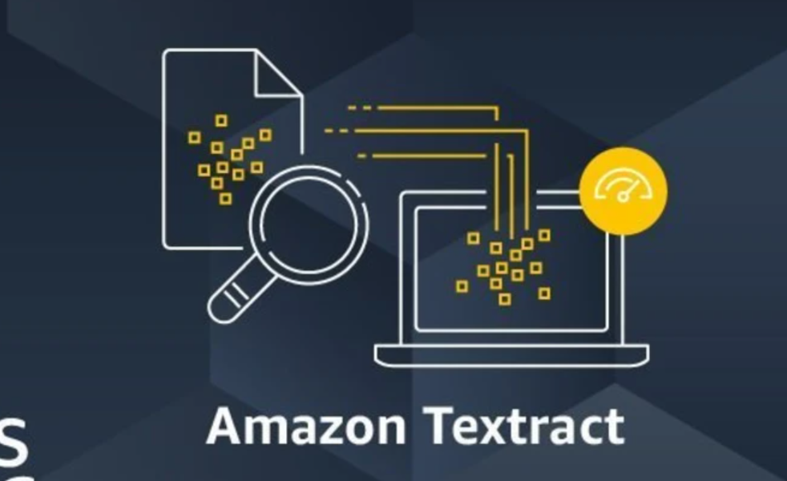
Technologies used:

Slide 12
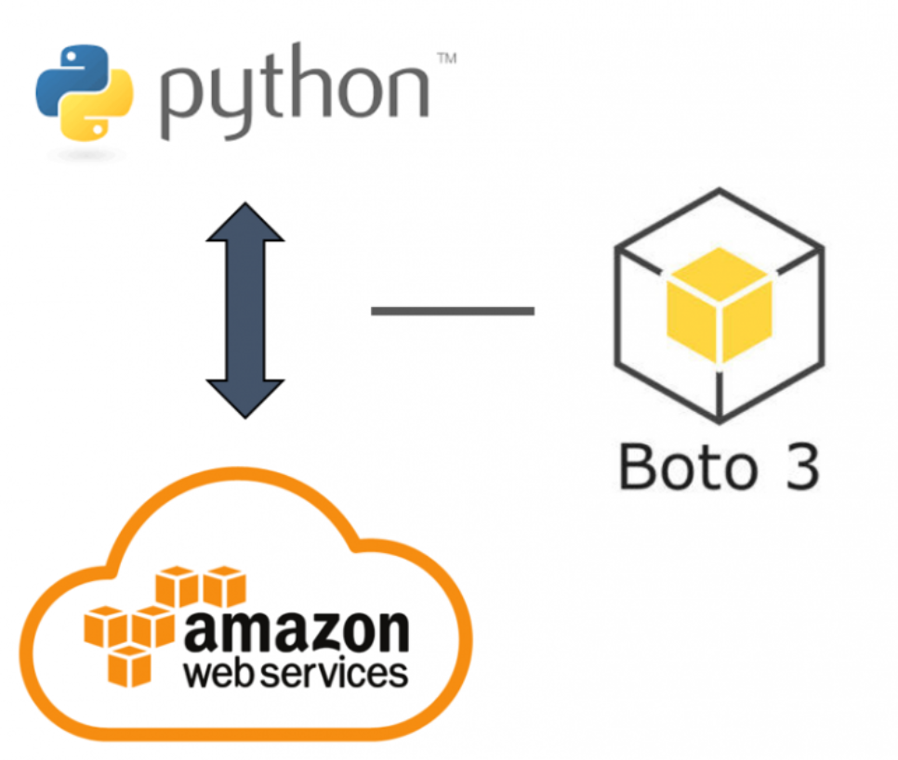
Working

Slide 13
5) Challenges & limitations
The major limitation of this project is that the API being used sometimes do not respond to the requests being made to it.
Also, the AWS account that we used was of free tier and that caused problem many times in calling the AWS services.

Slide 14
Future improvement:
To also include the conversion facility from text to pdf.
Also, to scan tables and charts from the documents along with text.
Make it more stable and faster.

Slide 15
6) Conclusion
This project helped in understanding the concepts of AWS and the various services offered by AWS.
It also helped in getting hands on BOTO3 SDK and its various functionalities.
Also learnt how to integrate AWS services in program with python script.

Slide 16
7)Annexures

Slide 17
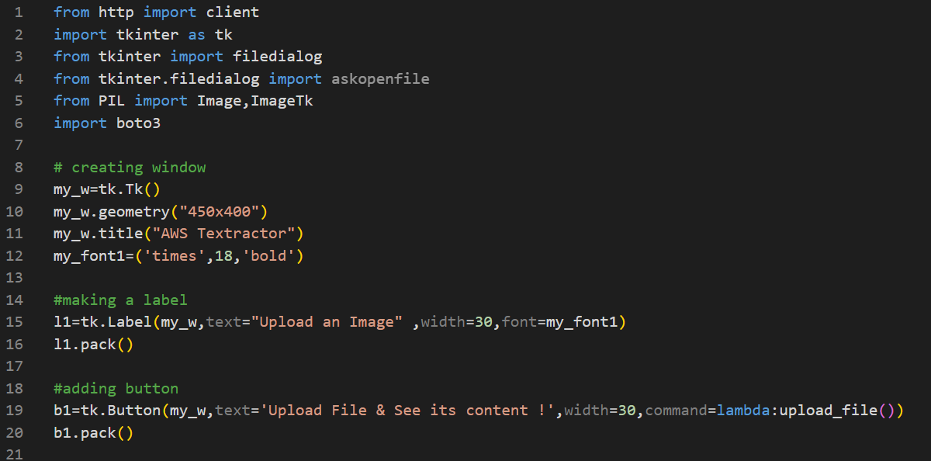
7a) Code Snippets

Slide 18
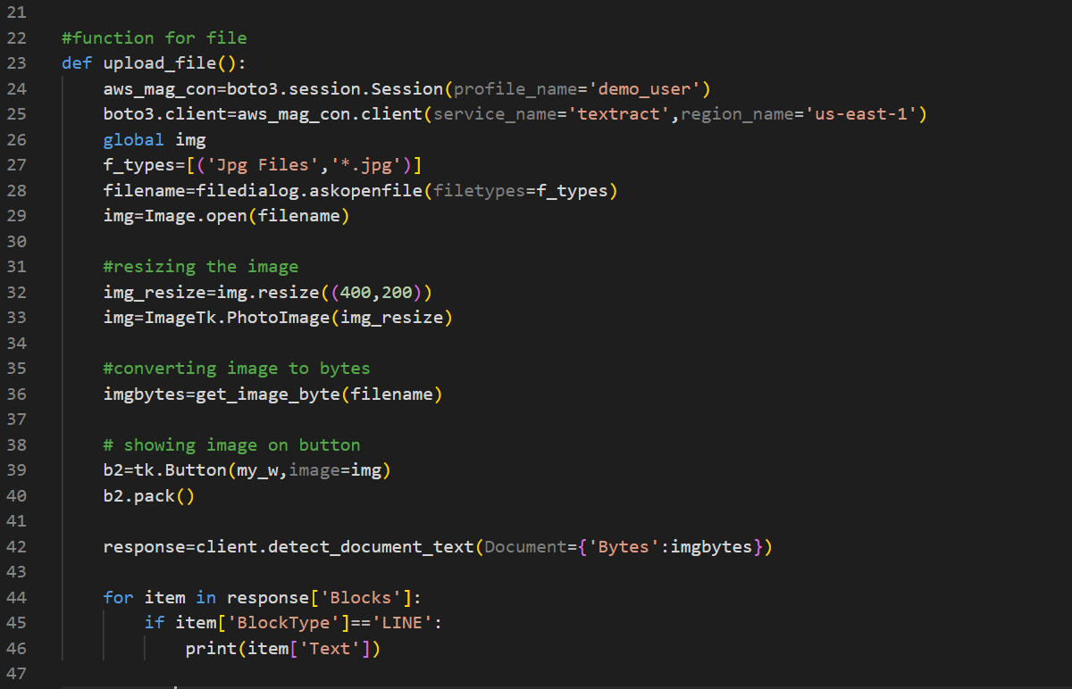
7b) Code Snippets

Slide 19
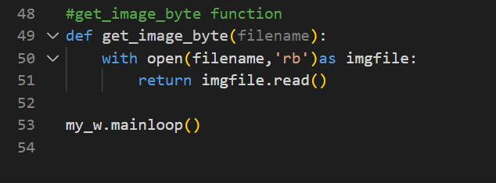
7c) Code Snippets

Slide 20
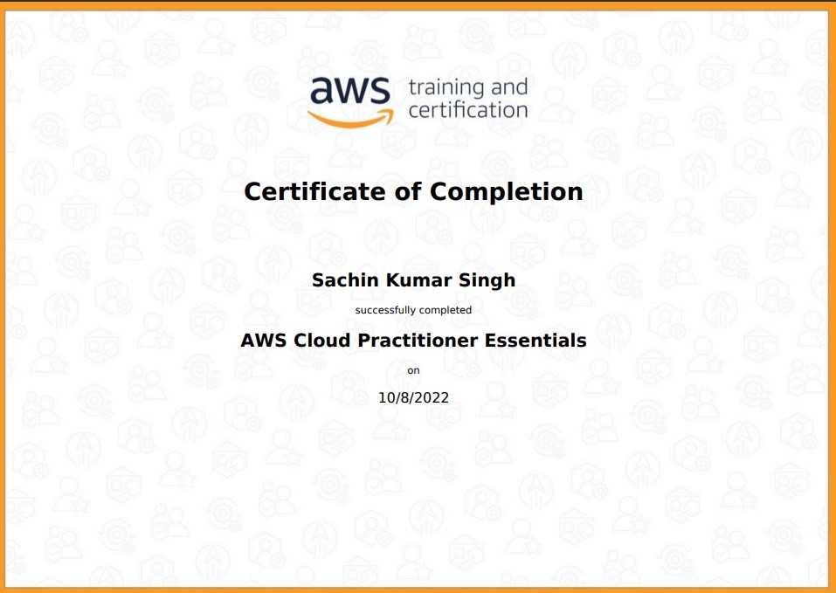
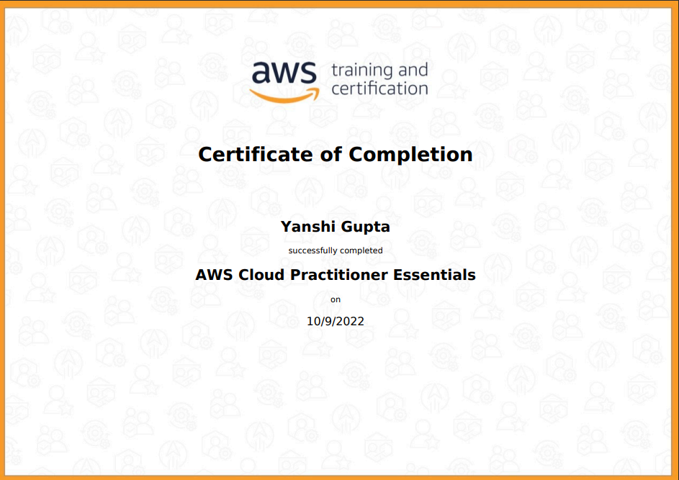
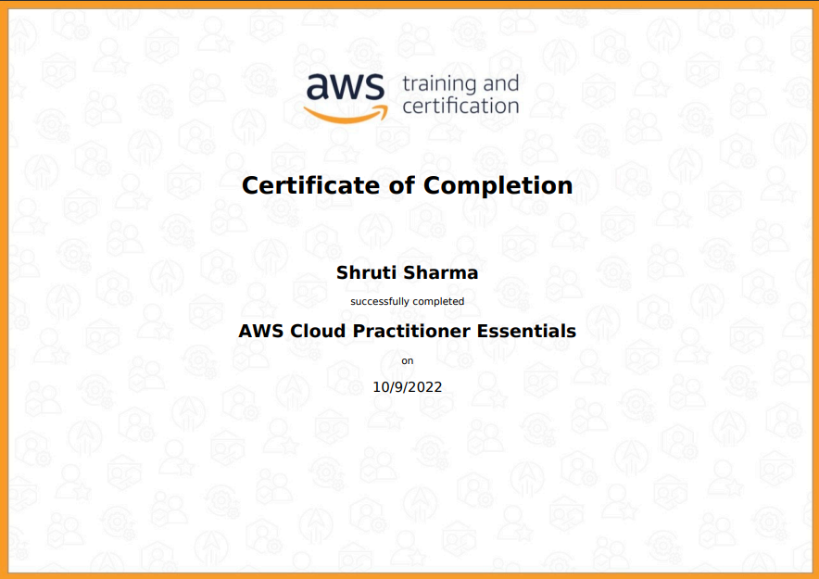
Certificate
Sachin Kumar Singh
Yanshi Gupta
Shruti Sharma

Slide 21
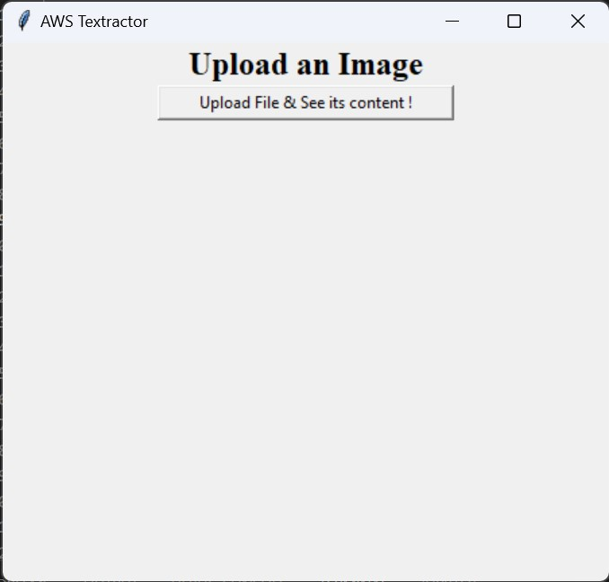
7c) Project Demo: Snippet 1
Starting the program

Slide 22
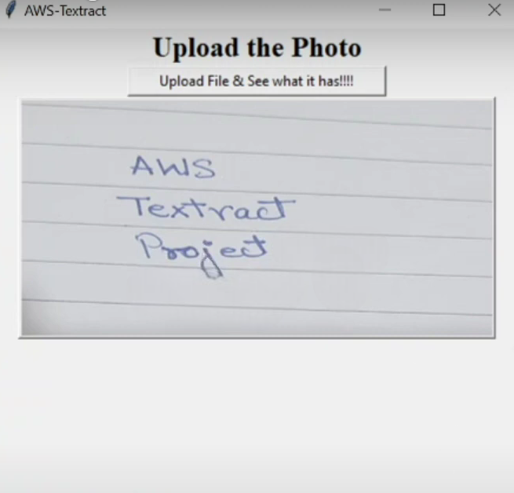
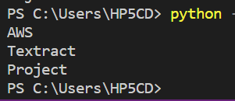
7c) Project Demo: Snippet 2
Uploading Image
Output

Slide 23
7d) Reference:
Tips and Tricks for Handling Configuration Files in Python
GeeksforGeeks | A computer science portal for geeks

Slide 24
Thank You

